Slide 1
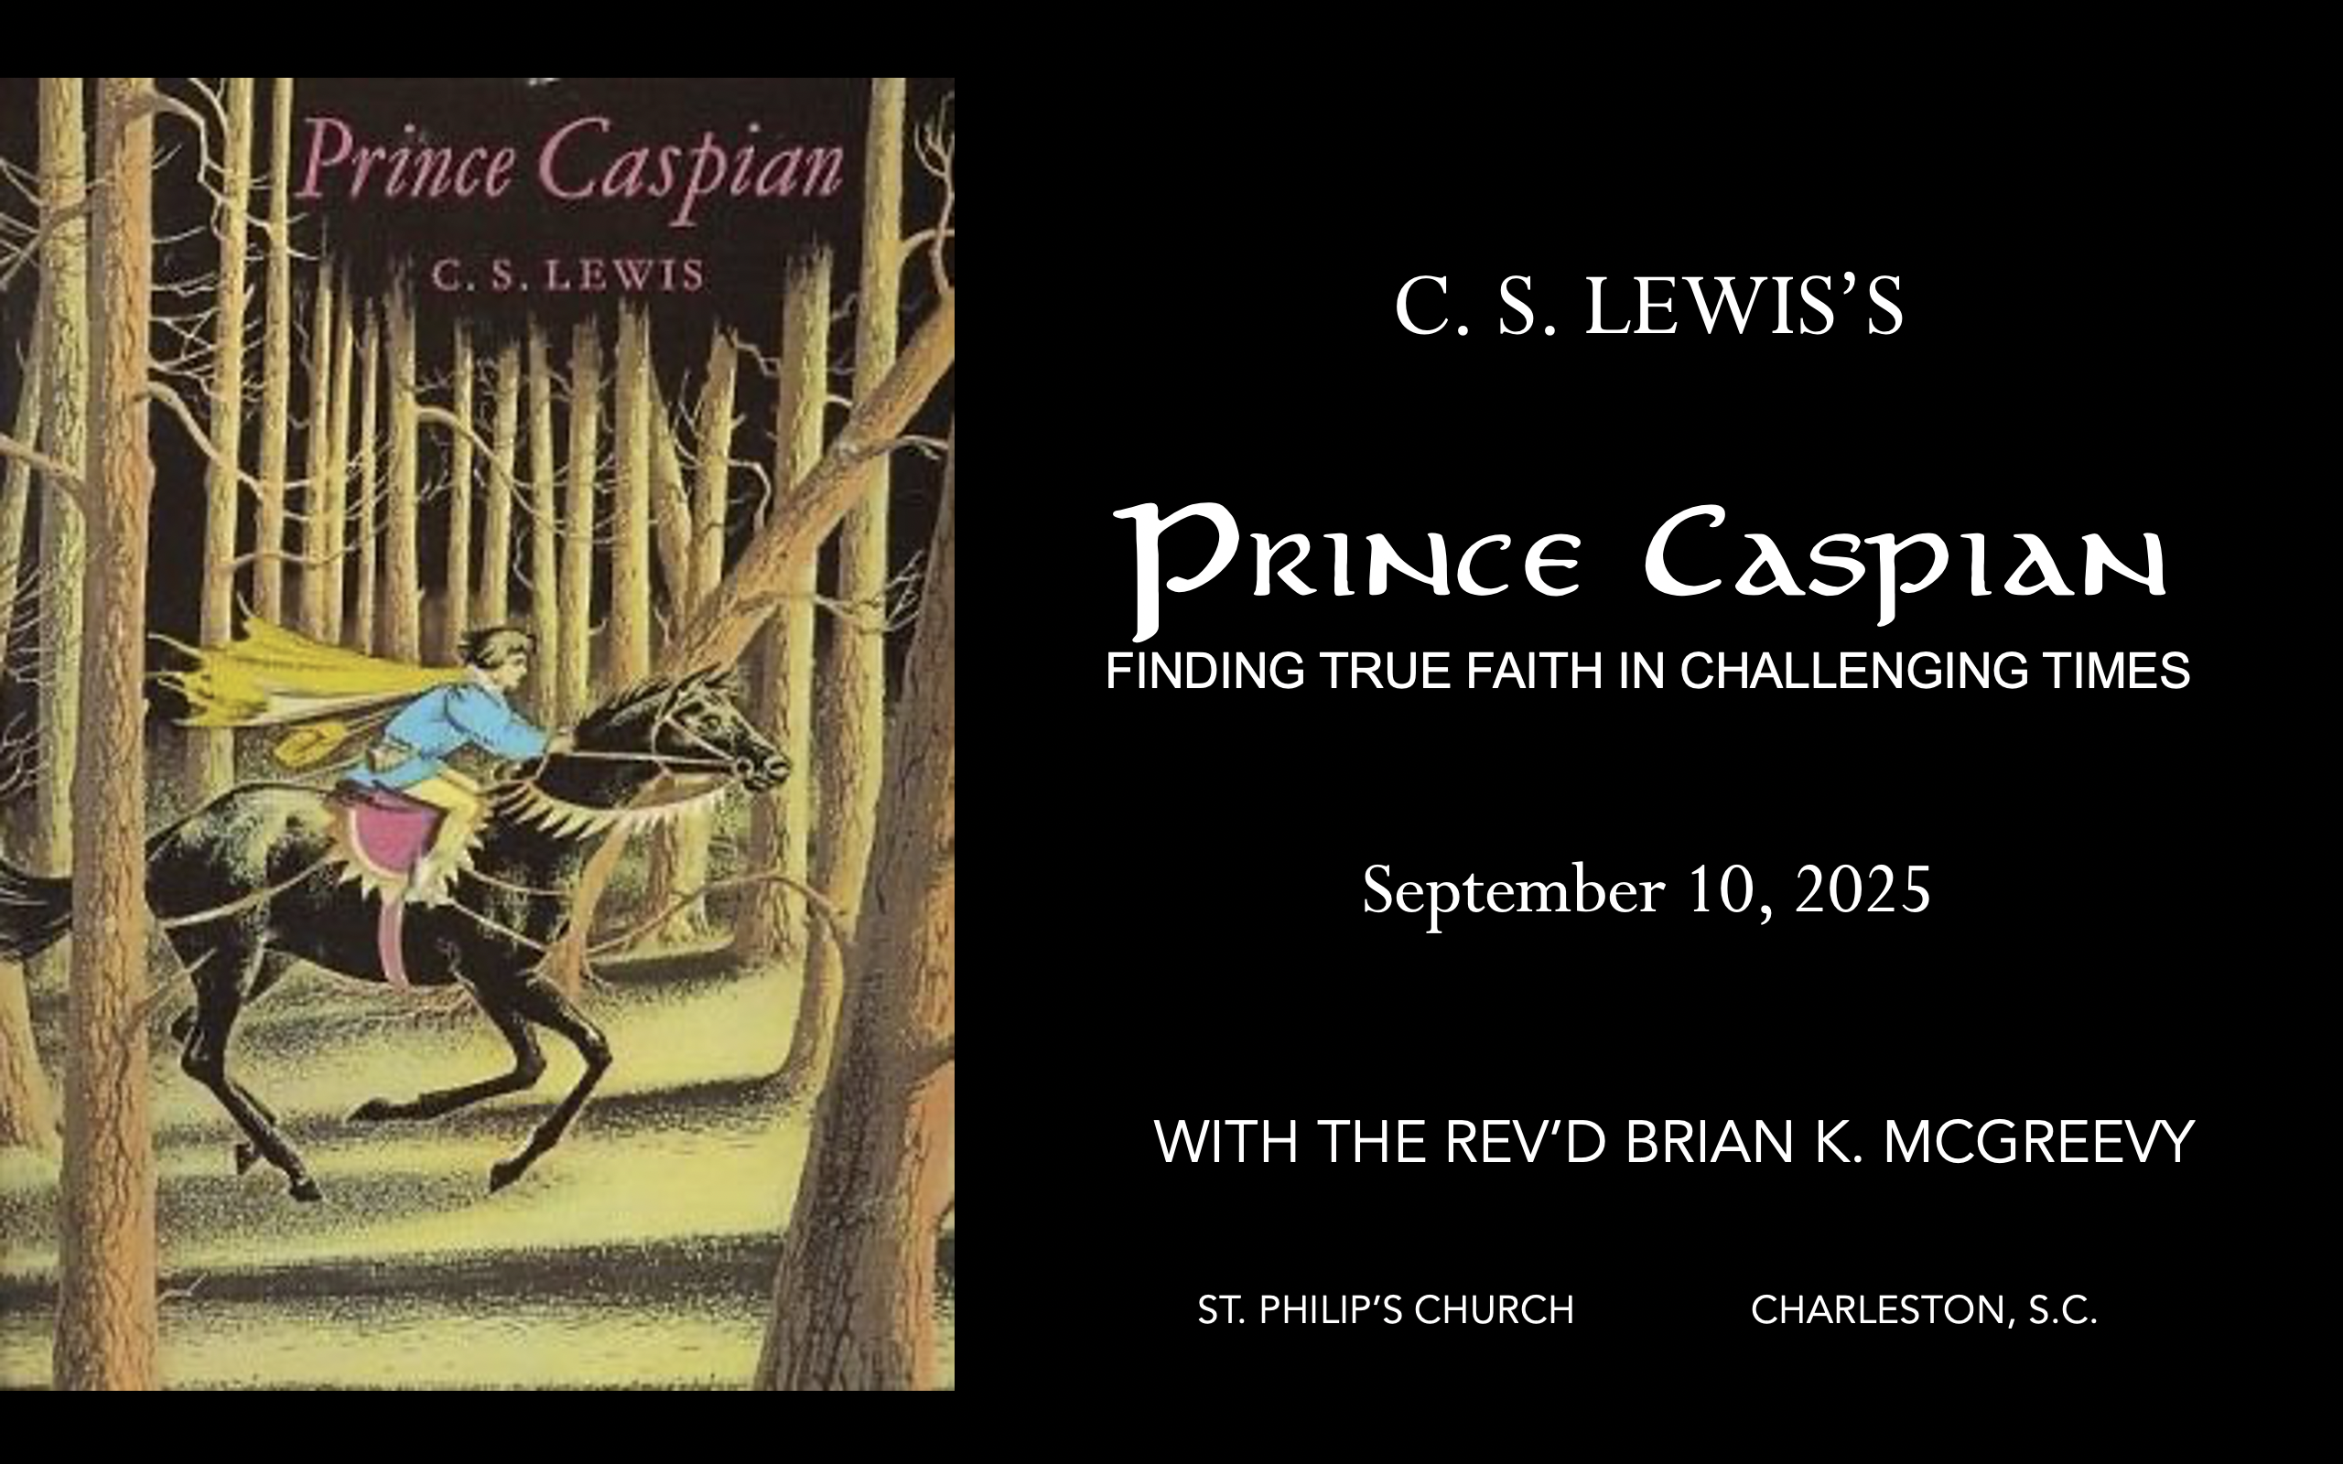


September 24, 2025
October 1, 2025
October 8, 2025

Slide 2

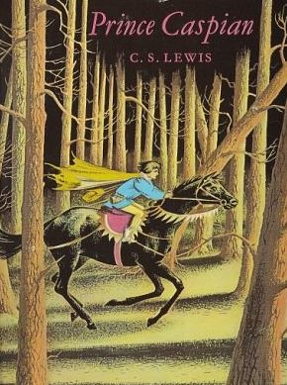
How to approach this class:
How to approach this class:
--On the beach
--Snorkeling
--Scuba diving
--Email list/QR code
How to read this book:
--Try reading aloud and slowly, looking for layers of meaning
--Look for themes/underline and highlight passages that resonate with you
What we’ll be doing:
--Setting the background and context
--Following the story chapter by chapter
--Drawing out principles for living with Joy and Purpose
--Looking at relevant Scripture

Slide 3
For you were once darkness, but now you are light in the Lord. Live as children of light (for the fruit of the light consists in all goodness, righteousness, and truth), and find out what pleases the Lord.
Have nothing to do with the fruitless deeds of darkness, but rather expose them. It is shameful even to mention what the disobedient do in secret. But everything exposed by the light becomes visible—and everything that is illuminated becomes a light. This is why it is said: “Wake up, sleeper, rise from the dead, and Christ will shine on you.” Be very careful, then, how you live— not as unwise but as wise, making the most of every opportunity because the days are evil.
Ephesians 5:8-15

Slide 4
Why Narnia matters SO much today
Aggressively secular narrative pervading our culture—how to counter?
Which Story Can We Trust? Either
We are here by accident, meaningless products of a random process. We create our own identity and can only invent meaning and purpose in life and do our best to stay alive—even though there is no point to life. Sartre, Dawkins, Nietzsche, most schools
OR
We are precious creatures made by and in the image of a loving God, who has created us for something special that we are asked to do. We have the privilege of being able to do good and experience purpose as we live by faith in Christ in His Kingdom. The witness of Scripture, the Church, and the saints
These two stories are totally incompatible. They can’t both be right: cognitive dissonance. So which do we trust? Other stories, like the Chronicles of Narnia, can help us here by highlighting dissonance or by creating a narrative we want to inhabit. So which do we trust? Is Jadis really the Queen of the realm of Queen Narnia? OR Is she the White Witch, a usurper in Narnia, which is really the realm of the mysterious great and noble lion, Aslan?
Gradually, one story about Narnia emerges as supremely plausible, as each individual story turns out to be part of this greater narrative. This grand narrative of interlocking stories makes sense of the riddles the children see and experience and reveals the character of each narrative. These stories teach that Biblical truth and the wisdom of the world cannot both be True---we need to learn to think critically because we are surrounded by falsehood.
We each have our unique story. But our own story needs to be brought into connection with a grand narrative, a big story which gives our story a new importance and significance. Why? Because we realize that our story is framed by something greater which gives us value and purpose. Lewis’s remarkable achievement in Narnia is to allow his readers to inhabit this big story, to get inside it and feel what it is like to be part of it. --Rev. Dr. Alister McGrath, Holder of the Andreas Idreos Chair in Science and Religion, Oxford University (Ph.D. in Molecular Biophysics, Doctor of Divinity in Theology, and Ph.D. in Intellectual History, at Oxford)

Slide 5
Imagination: What Does It Mean to Inhabit a Story
“The shaping of our loves, desires, and imagination thus happens primarily
The Narnia stories are deeply grounded in the Biblical story and its four major scenes of Creation, Fall, Redemption, and New Creation. The White Witch, Miraz, and other evil characters in the Narnia stories are all engaged in the evil enchantment of encouraging a
Disciplined Forgetting of Aslan, his Story, and the Deep Magic.

Slide 6
Why Prince Caspian is especially relevant today
Imagine living in a land
--that had forgotten its history and substituted a revisionist narrative that said all evidences of the Divine were foolish myths,
--where individuals struggled to practice their faith while being surrounded by a sea of doubters and skeptics,
--where Evil seemed poised to triumph over Good, and
-- where even the strongest believers wondered sometimes whether they had been abandoned.
Welcome to the world of Prince Caspian, the next book of the Chronicles of Narnia after The Lion, the Witch, and the Wardrobe. C.S. Lewis wrote that this book concerns the “restoration of the true religion after a corruption.
We will be examining such themes as
--how disbelief and doubt creep into our lives,
--the effects of living under the wrong framework of reality,
--the importance of cultivating virtue and courage, and
--the priority of seeking the Kingdom of God with our whole heart.

Slide 7
Chapter 3: “The Dwarf”
(Firing the imagination—The Dwarf!? What dwarf? Weren’t they alone? What could this mean?)
Peter, Susan, Edmund, and Lucy theorize about Narnian time and are debating about whether they might be able to swim off the island, when they see a boat coming towards them.
Two soldiers are on the boat and have a bundle that the children see is a bound dwarf whom the soldiers plan to drown; Susan scares them off by shooting one with an arrow that causes them to abandon the boat with the dwarf in it.
Peter and Susan pull the boat in, the dwarf is untied, and the dwarf thanks them, seeming surprised they are not ghosts. He is astonished and quite curious to learn there is a castle on the island.
The dwarf tells them he is a messenger of King Caspian the Tenth, who ought to be King of Narnia but is presently King only of the Old Narnians, who are a sort of rebellion.
Themes
There are realities and dimensions that are beyond us and outside of our material experience.
Misbeliefs about spiritual reality can be powerful and may dictate people’s behavior; they may also camouflage Evil.
People who have grown up believing lies have a difficult time when they encounter spiritual reality.
The way that we understand and interpret reality is through stories.
The temporal reality that we trust and take for granted may not in fact endure.

Slide 8
Chapter 4: “The Dwarf Tells of Prince Caspian” (Firing the imagination—Messenger of Caspian X? Who is this prince? Where did he come from?)
Prince Caspian is an orphan living in a grand castle in Narnia with his uncle Miraz, who is King of Narnia, and says Caspian will one day be King.
Caspian says he is not sure he wishes to be King and that he would rather have lived in the Old Days of Narnia with Talking Beasts and Aslan the Great Lion in charge; Miraz is infuriated and says all that is nonsense for babies and fairy tales and demands to know who told him such things.
Caspian’s beloved nurse is sent away for telling him about Narnia, and his new tutor Dr.Cornelius tells Caspian how his ancestors were Telmarines who conquered Narnia, but that the tales are True.
An astronomical conjunction of two planets provides the excuse for Dr. Cornelius to take Caspian up a high tower at night, where he explains many secrets, how the Telmarines ended Narnia as it was, how all Caspian has heard is True, how he must try to be like King Peter, how the lies about the ghosts in the Black Woods conceal Cair Paravel, and how Dr. Cornelius is actually half Dwarf.
Themes
Ambition and power are not to be prized for their own sake.
People in power can try to rewrite history and will then lie to protect their version of the story.
There is comfort in stories that are beautiful and redolent of Truth.
The beauty and path of the noble planets and stars is ordered by their Creator.
Remembering the Golden Age of freedom and happiness can help inspire a return to Truth.

Slide 9
Prince Caspian is an orphan living in a grand castle in Narnia with his uncle Miraz, who is King of Narnia, and says Caspian will one day be King.
“Prince Caspian lived in a great castle in the centre of Narnia with his uncle, Miraz, the King of Narnia, and his aunt, who had red hair and was called Queen Prunaprismia. His father and mother were dead and the person whom Caspian loved best was his nurse, and though (being a prince) he had wonderful toys which would do almost anything but talk, he liked best the last hour of the day when the toys had all been put back in their cupboards and Nurse would tell him stories. He did not care much for his uncle and aunt, but about twice a week his uncle would send for him and they would walk up and down together for half an hour on the terrace at the south side of the castle. One day, while they were doing this, the King said to him, "Well, boy, we must soon teach you to ride and use a sword. You know that your aunt and I have no children, so it looks as if you might have to be King when I'm gone. How shall you like that, eh?”
Caspian says he is not sure he wishes to be King and that he would rather have lived in the Old Days of Narnia with Talking Beasts and Aslan the Great Lion in charge; Miraz is infuriated and says all that is nonsense for babies and fairy tales and demands to know who told him such things.
"I don't know, Uncle," said Caspian. "Don't know, eh?" said Miraz. "Why, I should like to know what more anyone could wish for!" "All the same, I do wish," said Caspian. "What do you wish?" asked the King. "I wish — I wish — I wish I could have lived in the Old Days," said Caspian. (He was only a very little boy at the time.) Up till now King Miraz had been talking in the tiresome way that some grown-ups have, which makes it quite clear that they are not really interested in what you are saying, but now he suddenly gave Caspian a very sharp look. "Eh? What's that?" he said. "What old days do you mean?" "Oh, don't you know, Uncle?" said Caspian. "When everything was quite different. When all the animals could talk, and there were nice people who lived in the streams and the trees. Naiads and Dryads they were called. And there were Dwarfs. And there were lovely little Fauns in all the woods. They had feet like goats. And —" "That's all nonsense, for babies," said the King sternly. "Only fit for babies, do you hear? You're getting too old for that sort of stuff. At your age you ought to be thinking of battles and adventures, not fairy tales."

Slide 10
"Oh, but there were battles and adventures in those days," said Caspian. "Wonderful adventures. Once there was a White Witch and she made herself Queen of the whole country. And she made it so that it was always winter. And then two boys and two girls came from somewhere and so they killed the Witch and they were made Kings and Queens of Narnia, and their names were Peter and Susan and Edmund and Lucy. And so they reigned for ever so long and everyone had a lovely time, and it was all because of Aslan —" "Who's he?" said Miraz. And if Caspian had been a very little older, the tone of his uncle's voice would have warned him that it would be wiser to shut up. But he babbled on, "Oh, don't you know?" he said. "Aslan is the great Lion who comes from over the sea." "Who has been telling you all this nonsense?" said the King in a voice of thunder. Caspian was frightened and said nothing. "Your Royal Highness," said King Miraz, letting go of Caspian's hand, which he had been holding till now, "I insist upon being answered. Look me in the face. Who has been telling you this pack of lies?" "N — Nurse," faltered Caspian, and burst into tears.
"Stop that noise," said his uncle, taking Caspian by the shoulders and giving ham a shake. "Stop it. And never let me catch you talking — or thinking either — about all those silly stories again. There never were those Kings and Queens. How could there be two Kings at the same time? And there's no such person as Aslan. And there are no such things as lions. And there never was a time when animals could talk. Do you hear?" "Yes, Uncle," sobbed Caspian.

Slide 11
Caspian’s beloved nurse is sent away for telling him about Narnia, and his new tutor, Dr. Cornelius, tells Caspian how his ancestors were Telmarines who conquered Narnia, but that the tales are True.
Next day Caspian found what a terrible thing he had done, for Nurse had been sent away without even being allowed to say good-bye to him, and he was told he was to have a Tutor. Caspian missed his nurse very much and shed many tears; and because he was so miserable, he thought about the old stories of Narnia far more than before. He dreamed of Dwarfs and Dryads every night and tried very hard to make the dogs and cats in the castle talk to him. But the dogs only wagged their tails and the cats only purred. Caspian felt sure that he would hate the new Tutor, buy when the new Tutor arrived about a week later he turns out to be the sort of person it is almost impossible not to like. He was the smallest, and also the fattest, man Caspian had ever seen. He had a long, silvery, pointed beard which came down to his waist, and his face, which was brown and covered with wrinkles, looked very wise, very ugly, and very kind. His voice was grave and his eyes were merry so that, until you got to know him really well, it was hard to know when he was joking and when he was serious. His name was Doctor Cornelius.
"It was your Highness's ancestor, Caspian the First," said Doctor Cornelius, "who first conquered Narnia and made it his kingdom. It was he who brought all your nation into the country. You are not native Narnians at all. You are all Telmarines — that is, you all came from the Land of Telmar, far beyond the Western Mountains. That is why Caspian the First is called Caspian the Conqueror…"Listen," said the Doctor. "All you have heard about Old Narnia is true. It is not the land of Men. It is the country of Aslan, the country of the Waking Trees and Visible Naiads, of Fauns and Satyrs, of Dwarfs and Giants, of the gods and the Centaurs, of Talking Beasts. It was against these that the first Caspian fought. It is you Telmarines who silenced the beasts and the trees and the fountains, and who killed and drove away the Dwarfs and Fauns, and are now trying to cover up even the memory of them. The King does not allow them to be spoken of."

Slide 12
An astronomical conjunction of two planets provides the excuse for Dr. Cornelius to take Caspian up a high tower at night, where he explains many secrets, how the Telmarines ended Narnia as it was, how all Caspian has heard is True, how he must try to be like King Peter, how the lies about the ghosts in the Black Woods conceal Cair Paravel, and how Dr. Cornelius is actually half Dwarf.
A few days later his Tutor said, "Tonight I am going to give you a lesson in Astronomy. At dead of night two noble planets, Tarva and Alambil, will pass within one degree of each other. Such a conjunction has not occurred for two hundred years, and your Highness will not live to see it again. It was [a] long and steep [climb], but when they came out on the roof of the tower and Caspian had got his breath, he felt that it had been well worth it… There was no difficulty in picking out the two stars they had come to see. They hung rather low in the southern sky, almost as bright as two little moons and very close together. "Are they going to have a collision?" he asked in an awestruck voice. "Nay, dear Prince," said the Doctor. "The great lords of the upper sky know the steps of their dance too well for that. Look well upon them. Their meeting is fortunate and means some great good for the sad realm of Narnia. Tarva, the Lord of Victory, salutes Alambil, the Lady of Peace. They are just coming to their nearest."
"There are real Dwarfs still, and I've seen one at last." "So you've guessed it in the end," said Doctor Cornelius. "Or guessed it nearly right. I'm not a pure Dwarf. I have human blood in me too. Many Dwarfs escaped in the great battles and lived on, shaving their beards and wearing highheeled shoes and pretending to be men. They have mixed with your Telmarines. I am one of those, only a half-Dwarf, and if any of my kindred, the true Dwarfs, are still alive anywhere in the world, doubtless they would despise me and call me a traitor. But never in all these years have we forgotten our

Slide 13
own people and all the other happy creatures of Narnia, and the long-lost days of freedom.". "But how can I help?”[asked Caspian.] "You can be kind to the poor remnants of the Dwarf people, like myself. You can gather learned magicians and try to find a way of awaking the trees once more. You can search through all the nooks and wild places of the land to see if any Fauns or Talking Beasts or Dwarfs are perhaps still alive in hiding.”…I have often despaired; but something always happens to start me hoping again. But at least you can try to be a King like the High King Peter of old, and not like your uncle." "Then it's true about the Kings and Queens too, and about the White Witch?" said Caspian. "Certainly it is true," said Cornelius. "Their reign was the Golden Age in Narnia and the land has never forgotten them.”….”When the two sons of Adam and the two daughters of Eve were made Kings and Queens of Narnia by Aslan himself, they lived in the castle of Cair Paravel. No man alive has seen that blessed place and perhaps even the ruins of it have now vanished. But we believe it was far from here, down at the mouth of the Great River, on the very shore of the sea." "Ugh!" said Caspian with a shudder. "Do you mean in the Black Woods? Where all the — the — you know, the ghosts live?" "Your Highness speaks as you have been taught," said the Doctor. "But it is all lies. There are no ghosts there. That is a story invented by the Telmarines. Your Kings are in deadly fear of the sea because they can never quite forget that in all stories Aslan comes from over the sea… And the Kings and great men, hating both the sea and the wood, partly believe these stories, and partly encourage them. They feel safer if no one in Narnia dares to go down to the coast and look out to sea towards Aslan's land and the morning and the eastern end of the world."

Slide 14
Themes
Ambition and power are not to be prized for their own sake.
“[Caspian] did not care much for his uncle and aunt, but about twice a week his uncle would send for him and they would walk up and down together for half an hour on the terrace at the south side of the castle. One day, while they were doing this, the King said to him, "Well, boy, we must soon teach you to ride and use a sword. You know that your aunt and I have no children, so it looks as if you might have to be King when I'm gone. How shall you like that, eh?" "I don't know, Uncle," said Caspian. "Don't know, eh?" said Miraz. "Why, I should like to know what more anyone could wish for!”
Pride goes before destruction, and a haughty spirit before a fall. Proverbs 16:18 Everyone who is arrogant in heart is an abomination to the Lord; be assured, he will not go unpunished. Proverbs 16:5 For all that is in the world—the desires of the flesh and the desires of the eyes and pride of life—is not from the Father but is from the world. I John 2:16 But when his heart was lifted up and his spirit was hardened so that he dealt proudly, he was brought down from his kingly throne, and his glory was taken from him. Daniel 5:20But the Lord said to Samuel, “Do not look on his appearance or on the height of his stature, because I have rejected him. For the Lord sees not as man sees: man looks on the outward appearance, but the Lord looks on the heart.” I Samuel 16:7

Slide 15
People in power can try to rewrite history and will then lie to protect their version of the story.
“Once there was a White Witch and she made herself Queen of the whole country. And she made it so that it was always winter. And then two boys and two girls came from somewhere and so they killed the Witch and they were made Kings and Queens of Narnia, and their names were Peter and Susan and Edmund and Lucy. And so they reigned for ever so long and everyone had a lovely time, and it was all because of Aslan —" "Who's he?" said Miraz. And if Caspian had been a very little older, the tone of his uncle's voice would have warned him that it would be wiser to shut up. But he babbled on, "Oh, don't you know?" he said. "Aslan is the great Lion who comes from over the sea." "Who has been telling you all this nonsense?" said the King in a voice of thunder. Caspian was frightened and said nothing. "Your Royal Highness," said King Miraz, letting go of Caspian's hand, which he had been holding till now, "I insist upon being answered. Look me in the face. Who has been telling you this pack of lies?" "N — Nurse," faltered Caspian, and burst into tears. "Stop that noise," said his uncle, taking Caspian by the shoulders and giving ham a shake. "Stop it. And never let me catch you talking — or thinking either — about all those silly stories again. There never were those Kings and Queens. How could there be two Kings at the same time? And there's no such person as Aslan. And there are no such things as lions. And there never was a time when animals could talk. Do you hear?" "Yes, Uncle," sobbed Caspian.” "Remember the days of old; consider the years long past. Ask your father, and he will tell you, your elders, and they will instruct you” Deut 32:7 Remember the things of old, for I am God, and there is no other". Is. 46:9 "I will remember the works of the LORD; yes, I will remember Your wonders of old. I will reflect on all You have done and ponder Your mighty deeds". Ps. 77:11-12 Be careful that you do not forget the Lord your God, failing to observe his commands, his laws and his decrees that I am giving you this day. Otherwise, when you eat and are satisfied, when you build fine houses and settle down, and when your herds and flocks grow large and your silver and gold increase and all you have is multiplied, then your heart will become proud and you will forget the Lord your God, who brought you out of Egypt, out of the land of slavery. Deut. 8:11-14

Slide 16
There is comfort in stories that are beautiful and redolent of Truth.
"Then let's have no more of it," said the King. Then he called to one of the gentlemen-in-waiting who were standing at the far end of the terrace and said in a cold voice, "Conduct His Royal Highness to his apartments and send His Royal Highness's nurse to me AT ONCE." Next day Caspian found what a terrible thing he had done, for Nurse had been sent away without even being allowed to say good-bye to him, and he was told he was to have a Tutor. Caspian missed his nurse very much and shed many tears; and because he was so miserable, he thought about the old stories of Narnia far more than before. He dreamed of Dwarfs and Dryads every night and tried very hard to make the dogs and cats in the castle talk to him. But the dogs only wagged their tails and the cats only purred.”
Blessed be the God and Father of our Lord Jesus Christ, the Father of mercies and God of all comfort, who comforts us in all our affliction, so that we may be able to comfort those who are in any affliction, with the comfort with which we ourselves are comforted by God. 2 Cor. 1:3-4 The Lord is my shepherd; I shall not want. He makes me lie down in green pastures. He leads me beside still waters. He restores my soul. He leads me in paths of righteousness for his name's sake. Even though I walk through the valley of the shadow of death, I will fear no evil, for you are with me. Ps. 23 These things I remember as I pour out my soul: how I used to go to the house of God under the protection of the Mighty One with shouts of joy and praise among the festive throng. Why, my soul, are you downcast? Why so disturbed within me? Put your hope in God, for I will yet praise him, my Savior and my God. Ps. 42:4-5 How lovely is your dwelling place, O Lord of hosts! My soul longs, yes, faints for the courts of the Lord; my heart and flesh sing for joy to the living God. Even the sparrow finds a home, and the swallow a nest for herself, where she may lay her young, at your altars, O Lord of hosts, my King and my God. Blessed are those who dwell in your house, ever singing your praise! Ps. 84:1-4

Slide 17
The beauty and path of the noble planets and stars is ordered by their Creator.
“It was long and steep, but when they came out on the roof of the tower and Caspian had got his breath, he felt that it had been well worth it. Away on his right he could see, rather indistinctly, the Western Mountains. On his left was the gleam of the Great River, and everything was so quiet that he could hear the sound of the waterfall at Beaversdam, a mile away. There was no difficulty in picking out the two stars they had come to see. They hung rather low in the southern sky, almost as bright as two little moons and very close together. "Are they going to have a collision?" he asked in an awestruck voice. "Nay, dear Prince," said the Doctor (and he too spoke in a whisper). "The great lords of the upper sky know the steps of their dance too well for that. Look well upon them. Their meeting is fortunate and means some great good for the sad realm of Narnia. Tarva, the Lord of Victory, salutes Alambil, the Lady of Peace. They are just coming to their nearest.”
The heavens declare the glory of God, and the sky above proclaims his handiwork. Day to day pours out speech, and night to night reveals knowledge. There is no speech, nor are there word, whose voice is not heard. Their voice goes out through all the earth, and their words to the end of the world. In them he has set a tent for the sun, which comes out like a bridegroom leaving his chamber, and, like a strong man, runs its course with joy. Its rising is from the end of the heavens, and its circuit to the end of them, and there is nothing hidden from its heat. Ps. 19:1-6"By the word of the LORD the heavens were made, and all the stars by the breath of His mouth” Ps. 33:6 He determines the number of the stars; He calls them each by name". Ps. 147:4 Lift up your eyes and look to the heavens: Who created all these? He who brings out the starry host one by one and calls forth each of them by name. Because of his great power and mighty strength, not one of them is missing. Is. 40:26

Slide 18
Remembering the Golden Age of freedom and happiness can help inspire a return to Truth.
“I have often despaired; but something always happens to start me hoping again. I don't know. But at least you can try to be a King like the High King Peter of old, and not like your uncle." "Then it's true about the Kings and Queens too, and about the White Witch?" said Caspian. "Certainly it is true," said Cornelius. "Their reign was the Golden Age in Narnia and the land has never forgotten them…But never in all these years have we forgotten our own people and all the other happy creatures of Narnia, and the long-lost days of freedom.”
For the creation waits with eager longing for the revealing of the sons of God. For the creation was subjected to futility, not willingly, but because of him who subjected it, in hope that the creation itself will be set free from its bondage to corruption and obtain the freedom of the glory of the children of God. Romans 8:19 Was it not you who dried up the sea, the waters of the great deep, who made a road in the depths of the sea so that the redeemed might cross over? Those the Lord has rescued will return. They will enter Zion with singing; everlasting joy will crown their heads. Gladness and joy will overtake them, and sorrow and sighing will flee away. Isaiah 51:10-11 When the Lord restored the fortunes of Zion, we were like those who dream. Then our mouth was filled with laughter, and our tongue with shouts of joy; then they said among the nations, “The Lord has done great things for them.” The Lord has done great things for us; we are glad. Ps. 126:1-3 For this is the covenant that I will make with the house of Israel after those days, declares the Lord: I will put my law within them, and I will write it on their hearts. And I will be their God, and they shall be my people. And no longer shall each one teach his neighbor and each his brother, saying, ‘Know the Lord,’ for they shall all know me, from the least of them to the greatest, declares the Lord. For I will forgive their iniquity, and I will remember their sin no more.” Jer. 31:33-34

Slide 19
DEEPER DIVE: Addison’s Walk, Mythopoeia, Longing for Restoration, and the Coming Together of Truth, Beauty, and Goodness
“How deep I am just now beginning to see: for I have just passed on from believing in God to definitely believing in Christ – in Christianity… My long night talk with Dyson and Tolkien had a good deal to do with it. What Dyson and Tolkien showed me was that if I met the idea of sacrifice in a Pagan story I didn’t mind it at all: again, that if I met the idea of a god sacrificing himself to himself I liked it very much and was mysteriously moved by it: again that the idea of the dying and reviving god similarly moved me provided I met it anywhere except the Gospels.
“The reason was that in Pagan stories I was prepared to feel the myth as profound and suggestive of meanings beyond my grasp even tho’ I could not say in cold prose ‘what it meant’. Now the story of Christ is simply a true myth: a myth working on us in the same way as the others, but with this tremendous difference that it really happened: and one must be content to accept it in the same way, remembering that it is God’s myth where the others are men’s myths. (Lewis letter, October 18, 1931)
“Mythpoeia”– poem written by Tolkien for Lewis in 1931 about their conversation on Addison’s Walk that led to Lewis’s conversion. The dedication reads
To one who said that myths were lies and therefore worthless, even though 'breathed through silver
Philomythus to Misomythus

Slide 20
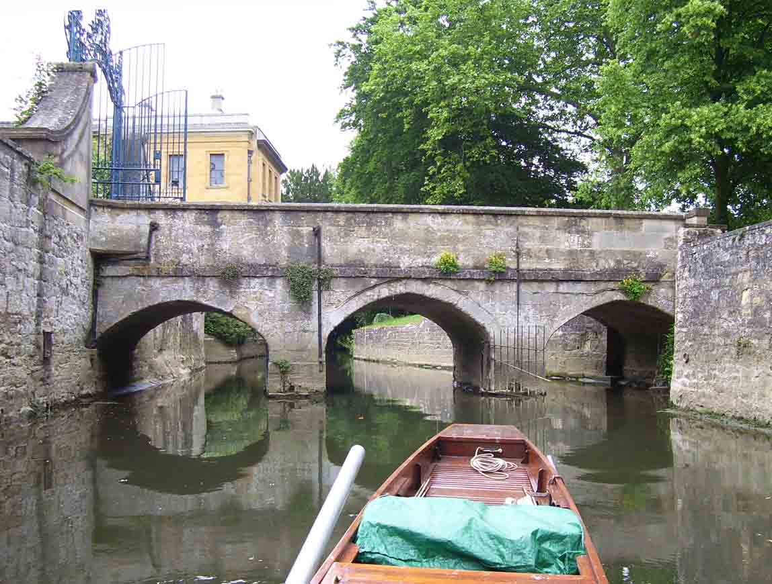
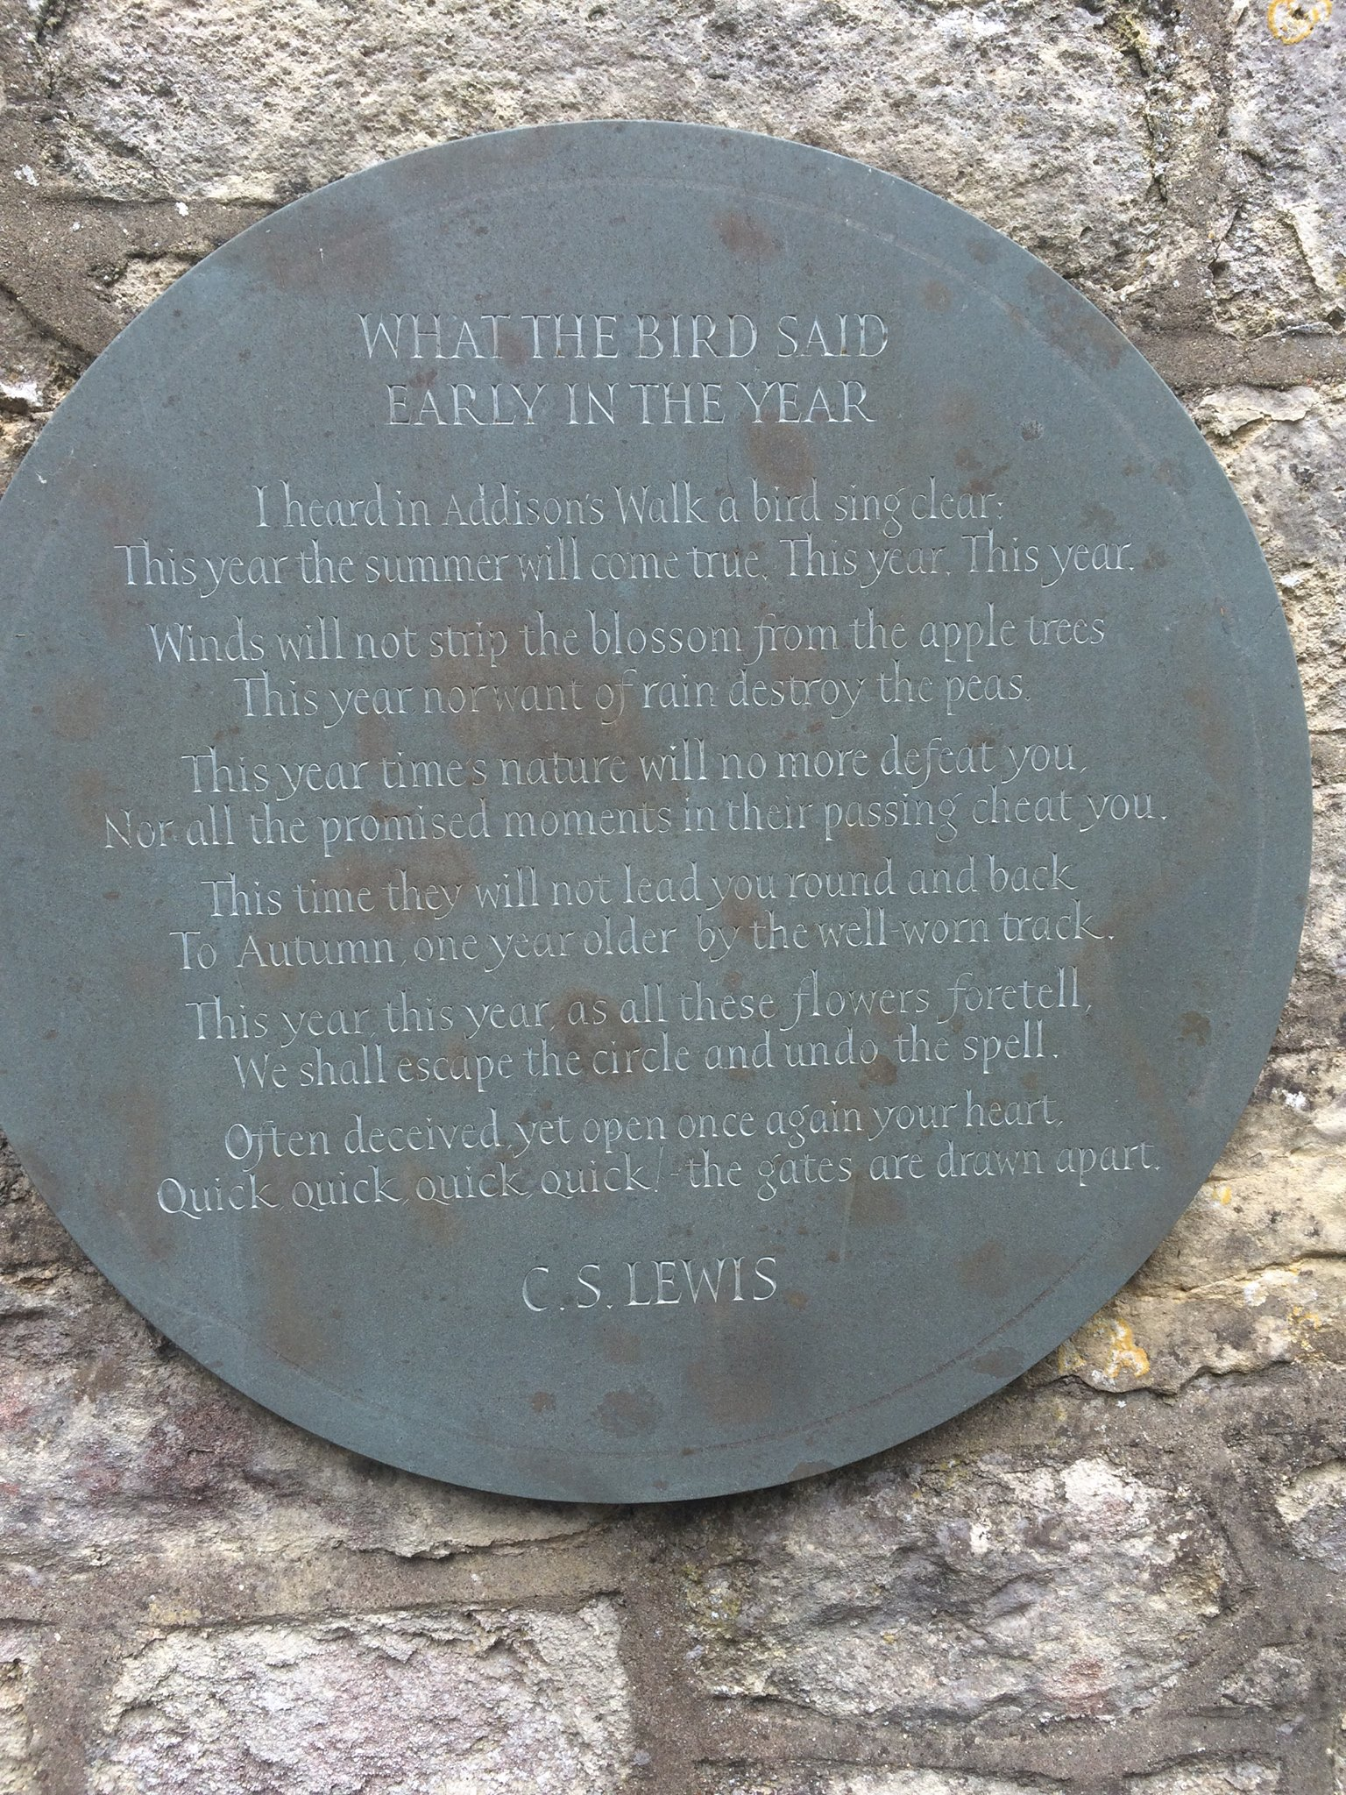
DEEPER DIVE: Addison’s Walk, Mythopoeia, and the Coming Together of Truth, Beauty, and Goodness
“How deep I am just now beginning to see: for I have just passed on from believing in God to definitely believing in Christ – in Christianity… My long night talk with Dyson and Tolkien had a good deal to do with it. What Dyson and Tolkien showed me was that if I met the idea of sacrifice in a Pagan story I didn’t mind it at all: again, that if I met the idea of a god sacrificing himself to himself I liked it very much and was mysteriously moved by it: again that the idea of the dying and reviving god similarly moved me provided I met it anywhere except the Gospels.
“The reason was that in Pagan stories I was prepared to feel the myth as profound and suggestive of meanings beyond my grasp even tho’ I could not say in cold prose ‘what it meant’. Now the story of Christ is simply a true myth: a myth working on us in the same way as the others, but with this tremendous difference that it really happened: and one must be content to accept it in the same way, remembering that it is God’s myth where the others are men’s myths. (Lewis letter, October 18, 1931)

Slide 21
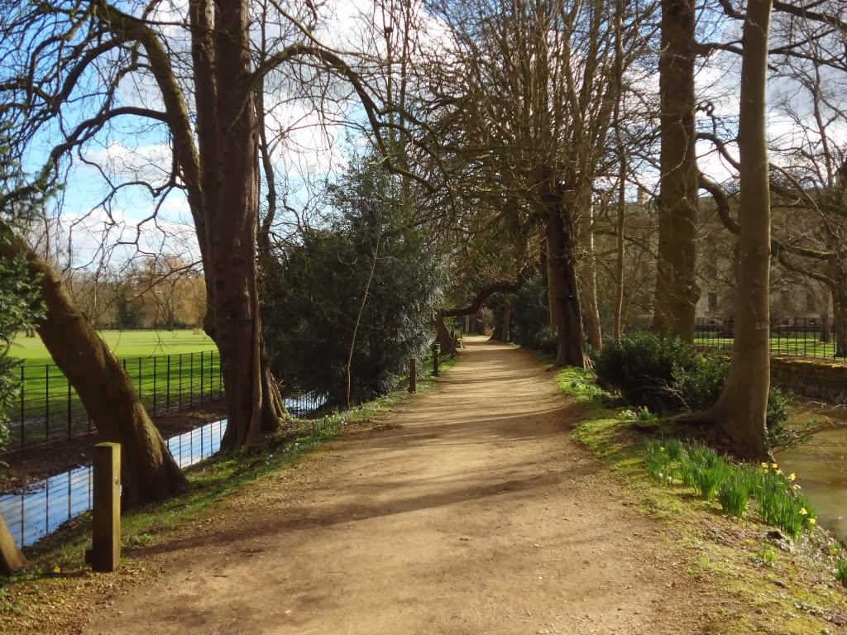
Remembering the Golden Age of freedom and happiness can help inspire a return to Truth.
“I have often despaired; but something always happens to start me hoping again. I don't know. But at least you can try to be a King like the High King Peter of old, and not like your uncle." "Then it's true about the Kings and Queens too, and about the White Witch?" said Caspian. "Certainly it is true," said Cornelius. "Their reign was the Golden Age in Narnia and the land has never forgotten them…But never in all these years have we forgotten our own people and all the other happy creatures of Narnia, and the long-lost days of freedom.”
For the creation waits with eager longing for the revealing of the sons of God. For the creation was subjected to futility, not willingly, but because of him who subjected it, in hope that the creation itself will be set free from its bondage to corruption and obtain the freedom of the glory of the children of God. Romans 8:19 Was it not you who dried up the sea, the waters of the great deep, who made a road in the depths of the sea so that the redeemed might cross over? Those the Lord has rescued will return. They will enter Zion with singing; everlasting joy will crown their heads. Gladness and joy will overtake them, and sorrow and sighing will flee away. Isaiah 51:10-11 When the Lord restored the fortunes of Zion, we were like those who dream. Then our mouth was filled with laughter, and our tongue with shouts of joy; then they said among the nations, “The Lord has done great things for them.” The Lord has done great things for us; we are glad. Ps. 126:1-3 For this is the covenant that I will make with the house of Israel after those days, declares the Lord: I will put my law within them, and I will write it on their hearts. And I will be their God, and they shall be my people. And no longer shall each one teach his neighbor and each his brother, saying, ‘Know the Lord,’ for they shall all know me, from the least of them to the greatest, declares the Lord. For I will forgive their iniquity, and I will remember their sin no more.” Jer. 31:33-34

Slide 22
Excerpt
He sees no stars who does not see them first
of living silver made that sudden burst
to flame like flowers beneath an ancient song,
whose very echo after-music long
has since pursued. There is no firmament,
only a void, unless a jeweled tent
myth-woven and elf-patterned; and no earth,
unless the mother's womb whence all have birth.
The heart of Man is not compound of lies,
but draws some wisdom from the only Wise,
and still recalls him. Though now long estranged,
Man is not wholly lost nor wholly changed.
Dis-graced he may be, yet is not dethroned,
and keeps the rags of lordship once he owned,
his world-dominion by creative act:
not his to worship the great Artefact,
Man, Sub-creator, the refracted light
through whom is splintered from a single White
to many hues, and endlessly combined
in living shapes that move from mind to mind.
Though all the crannies of the world we filled
with Elves and Goblins, though we dared to build
Gods and their houses out of dark and light, and sowed the seed of dragons, 'twas our right
(used or misused). The right has not decayed.
We make still by the law in which we're made.
Yes! ‘wish-fulfilment dreams' we spin to cheat
our timid hearts and ugly Fact defeat!
Whence came the wish, and whence the power to dream,
or some things fair and others ugly deem?
All wishes are not idle, nor in vain
fulfilment we devise -- for pain is pain,
not for itself to be desired, but ill;
or else to strive or to subdue the will
alike were graceless; and of Evil this
alone is deadly certain: Evil is.
Blessed are the timid hearts that evil hate
that quail in its shadow, and yet shut the gate;
that seek no parley, and in guarded room,
though small and bare, upon a clumsy loom
weave tissues gilded by the far-off day
hoped and believed in under Shadow's sway.
Blessed are the men of Noah's race that build
their little arks, though frail and poorly filled,
and steer through winds contrary towards a wraith,
a rumour of a harbour guessed by faith.

Slide 23
He sees no stars who does not see them first
\
Blessed are the legend-makers with their rhyme
of things not found within recorded time.
It is not they that have forgot the Night,
or bid us flee to organized delight,
in lotus-isles of economic bliss
forswearing souls to gain a Circe-kiss
(and counterfeit at that, machine-produced,
bogus seduction of the twice-seduced).
Such isles they saw afar, and ones more fair,
and those that hear them yet may yet beware.
They have seen Death and ultimate defeat,
and yet they would not in despair retreat,
but oft to victory have tuned the lyre
and kindled hearts with legendary fire,
illuminating Now and dark Hath-been
with light of suns as yet by no man seen.
I would that I might with the minstrels sing
and stir the unseen with a throbbing string.
I would be with the mariners of the deep
that cut their slender planks on mountains steep
and voyage upon a vague and wandering quest,
for some have passed beyond the fabled West.
I would with the beleaguered fools be told,
that keep an inner fastness where their gold,
impure and scanty, yet they loyally bring
to mint in image blurred of distant king,
or in fantastic banners weave the sheen
heraldic emblems of a lord unseen.

Slide 24
“Today, many of us are under the spell of modernity, post-modernity, or other worldly philosophies which in their own way distort and suppress the knowledge of God and the deepest longings of the human heart. Breaking free of their enchantment can only come from opening ourselves to God in a new way and asking him to draw us into a deeper fellowship with his Spirit, to renew our minds and to restore his image in us— a prayer he is most willing to answer.”
From C.S. Lewis Institute Reflections January 2010
Instead, they were longing for a better country—a heavenly one. Therefore God is not ashamed to be called their God, for he has prepared a city for them.
HEBREWS 11:16
And there's another country, I've heard of long ago
Most dear to them that love her, most great to them that know
We may not count her armies, we may not see her king
Her fortress is a faithful heart, her pride is suffering
And soul by soul, and silently her shining bounds increase
And her ways are ways of gentleness, and all her paths are peace.
Sir Cecil Spring-Rice, 1918

